Slide 1
ITIL Service Operation Function Service Desk
Functions under SO (Service Operation)
Faglærer: Kasim M. Ali

Slide 2
Service Operation Functions
1. Service Desk:
The ITIL definition of the service desk is the single point of contact between the service provider and the users.
The service desk is a key function of Service Operation. It provides a single, central point of contact for all users of IT.
Service desk staff execute the incident management and request fulfillment processes to restore normal service to users as quickly as possible.
Restoring normal service could involve fixing a technical fault, fulfilling a service request, or answering a query — whatever is needed to enable users to return to their work.
The service desk provides an interface to other service operation processes and activities.

Slide 3
Service Operation Functions / Service Desk
The service desk’s specific responsibilities are:
Logging, categorizing, and prioritizing all calls
Providing first-line investigation and problem diagnosis
Resolving incidents or service requests when first contacted or whenever possible
Escalating incidents and service requests that cannot be resolved within agreed-on time limits
Closing resolved incidents, requests, and other calls
Communicating with users to keep them informed of progress, impending changes, agreed-on outages, and other such notifications.

Slide 4
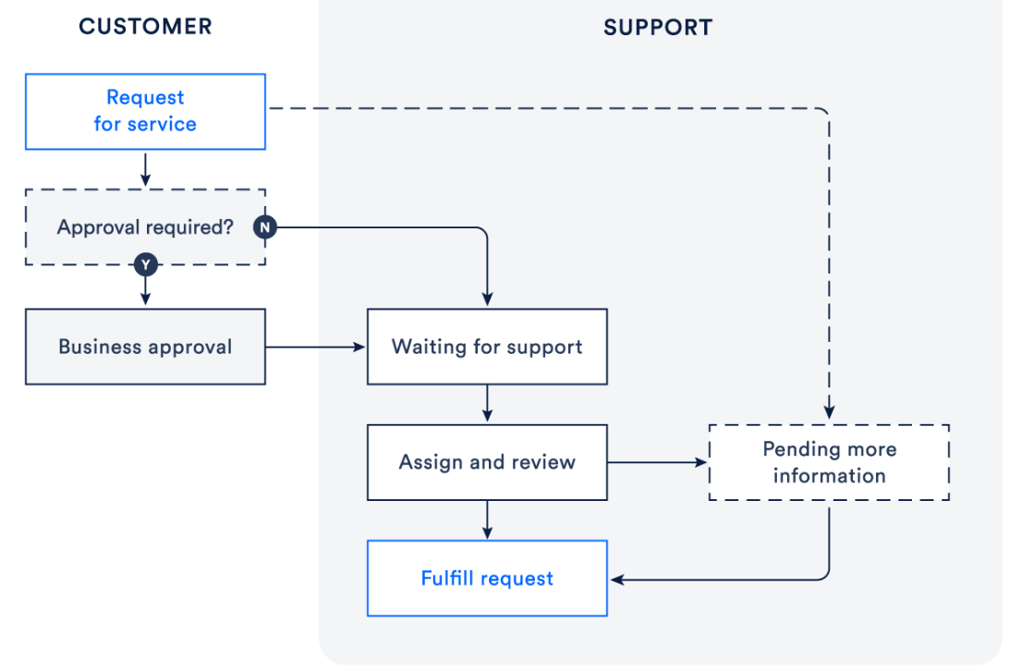
Service request management fulfillment process
The service request fulfillment process, in brief:
A customer requests help from your service catalog or via email.
The service desk team assesses the request alongside pre-defined approval and qualification processes. If needed, they send the request for financial or business approval.
A service desk agent works to fulfill the service request, or forwards the request to someone who can.
After resolving the request, the service desk closes the ticket. The agent consults the customer to make sure they are satisfied.

Slide 5
Service Operation Functions
1) Service Desk:
Is the first and single point of contact (er det første og det eneste kontaktpunkt)
It is responsible for managing logged tickets, coordinating between end user and IT service provider team.
It plays a significant role in maintaining customer satisfaction by ensuring timely closure of user requests.
2) Technical Management:
Technical Management provides technical expertise.
3) IT Operations Management: This function includes two sub-functions.
3.1) It Operations Control:
Executes day-to-day routine tasks related to the operation of infrastructure components and applications.
This includes job scheduling, backup.
3.2) Facilities Management:
Managing the physical environment, such as power, cooling, building access etc.
4) Applications Management:
Application Management is responsible for managing applications throughout their lifecycle.

